Slide 1



IOT BASED SOUND POLLUTION MONITORING SYSTEM
By
RAJARAJAN R | (713621106334)
Under the guidance Of
Ms. Elakkiya (Assistant Professor) SREE SAKTHI ENGINEERING COLLEGE Approved By AICTE, Affiliated to Anna University, Chennai Accredited By NAAC. Ooty main Road, Karamdai, Coimbatore – 641104, India

Slide 2
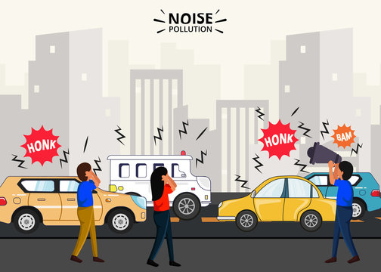
INTRODUCTION
Introduction to Noise Pollution
Noise pollution is a growing concern in urban areas, affecting the health and well-being of millions of people worldwide. Excessive noise can cause hearing loss, sleep disturbance, cardiovascular disease, and other adverse health effects. In this presentation, we will introduce a noise pollution monitoring system using Arduino, a popular open-source microcontroller platform that can be easily programmed and customized for various applications.

Slide 3
Existing Noise Monitoring Systems
Automated Noise Monitoring
Automated noise monitoring systems use sensors and software to continuously measure and record noise levels. The data is transmitted wirelessly to a central database for analysis and visualization.
These systems are more accurate and efficient than manual monitoring, as they can operate 24/7 and provide real-time data. They also require less human resources and can cover a wider area.
However, automated noise monitoring systems can be expensive to install and maintain. They also require a stable power source and internet connection, which may not be available in all locations.
Manual Noise Monitoring
Manual noise monitoring is the traditional method of measuring noise levels. It involves using sound level meters to measure the intensity of sound in decibels (dB) at different locations. The readings are then recorded manually on paper or a spreadsheet for later analysis.
Manual noise monitoring is time-consuming and requires significant human resources. It also has limitations in terms of accuracy, as it is subject to human error and can be affected by external factors such as weather conditions.

Slide 4

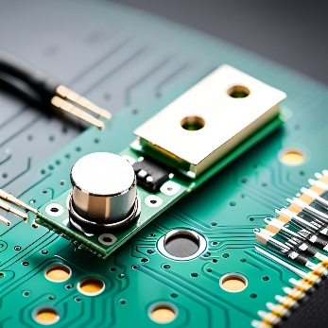
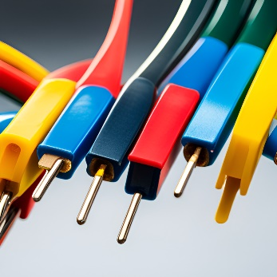
Components Required
Arduino UNO Board
The Arduino UNO board is the main component of the system and serves as the brain of the project. It is responsible for controlling the sound sensor module and collecting data from it. The board comes with a microcontroller, which is programmed using the Arduino software.
Sound Sensor Module
The sound sensor module is the primary sensor used in the system. It detects sound waves and converts them into electrical signals, which are then processed by the Arduino board.
Sound Sensor Module
The sound sensor module is the primary sensor used in the system. It detects sound waves and converts them into electrical signals, which are then processed by the Arduino board. The module has a built-in amplifier that increases the sensitivity of the sensor, making it ideal for detecting noise pollution.

Slide 5
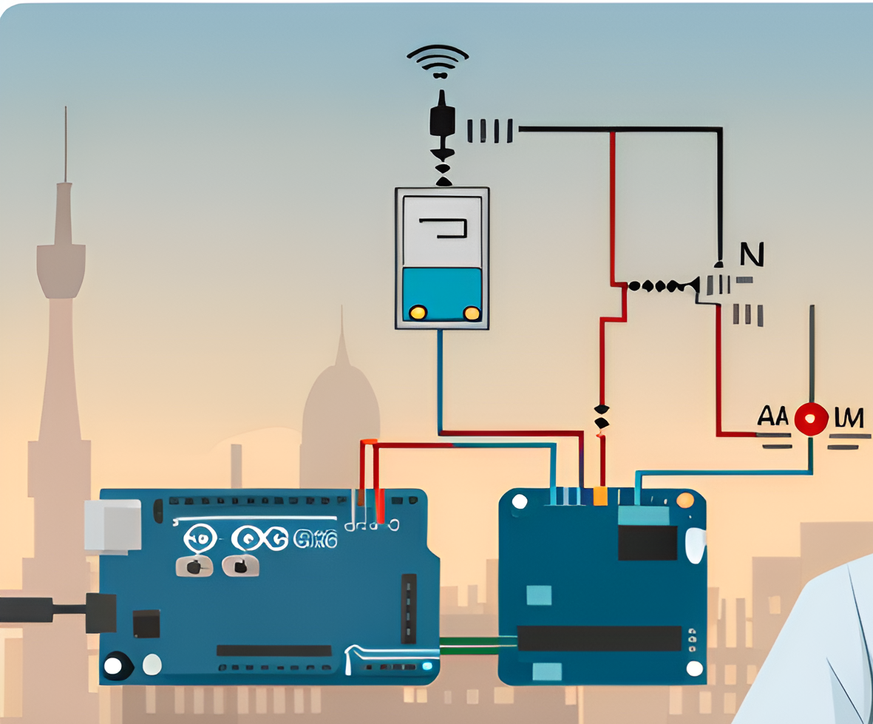
Circuit Diagram

Slide 6
Code for the System
Arduino Sketch
The following code is an example sketch for the noise pollution monitoring system using Arduino:
int soundSensor = A0;
void setup() {
Serial.begin(9600);
}
void loop() {
int soundLevel = analogRead(soundSensor);
Serial.println(soundLevel);
delay(1000);
}

Slide 7
Data Collection and Storage
The noise pollution monitoring system using Arduino collects data from the sound sensor and stores it in a microSD card. The system is designed to record sound levels at specific intervals, which can be adjusted based on the user's requirements. The collected data can be used for further analysis and visualization.
Data Collection
The sound sensor is connected to the Arduino board, which is programmed to collect data at specific intervals. The data is collected in decibels (dB) and is stored in the microSD card. The system can be programmed to collect data continuously or at specific intervals, depending on the user's requirements.
Data Storage
The collected data is stored in a microSD card, which can be easily removed and analyzed using a computer. The data is stored in a CSV format, which can be easily imported into spreadsheet software for further analysis.

Slide 8

Data Visualization
Once the noise pollution data is collected and stored, it is important to visualize the data in a meaningful way. This can help identify patterns and trends in the noise levels, and provide insights for further analysis. There are several tools available for data visualization, including MATLAB, Python, and Tableau. These tools can be used to create charts, graphs, and maps that make it easy to understand the noise pollution levels in different areas over time.
Charts and graphs can be used to display the noise levels at different times of day, or over a period of weeks or months. Heat maps can be used to show the noise levels in different areas of a city, highlighting areas that are particularly noisy. Bar charts can be used to compare the noise levels in different locations, or to show changes in noise levels over time.

Slide 9

Sound Analysis Techniques
The noise pollution monitoring system using Arduino can collect and store sound data from the environment. However, to make sense of this data, sound analysis techniques are required. These techniques can help identify patterns in the sound data and provide insights into the sources of noise pollution. Some common sound analysis techniques include:
Spectral analysis: This technique involves breaking down the sound signal into its individual frequency components to identify the different sound sources.Waveform analysis: This technique involves analyzing the shape of the sound wave to identify specific sound characteristics such as amplitude and duration.Statistical analysis

Slide 10
Calibration and Accuracy
Calibration
To ensure accurate readings, the noise pollution monitoring system should be calibrated regularly. Calibration involves comparing the readings of the system with a reference instrument and adjusting the system to match the reference instrument. Calibration should be done in a quiet environment with no external noise sources.
Accuracy
The accuracy of the system depends on the quality of the components used and the calibration process. The system should be able to measure noise levels accurately within a range of frequencies and decibels. It is important to ensure that the system is not affected by external factors such as temperature and humidity, which can affect the accuracy of the readings.

Slide 11
Testing and Validation
Ensuring Accuracy and Reliability
Before deploying the noise pollution monitoring system in real-world scenarios, it is important to test and validate its accuracy and reliability. This involves comparing the readings from the system with those obtained from a reference instrument, such as a sound level meter. The system should be able to measure sound levels accurately under different conditions, such as varying noise frequencies, intensities, and durations.
Field Testing and Validation
Once the system has been tested in a controlled environment, it should be field-tested to validate its performance in real-world scenarios. This involves deploying the system at different locations and comparing its readings with those obtained from reference instruments. The system should be able to operate reliably under different weather conditions, such as rain, wind, and extreme temperatures.

Slide 12
Applications of the System
Urban Planning and Development
The noise pollution monitoring system can be used by urban planners to identify areas that are most affected by noise pollution. This information can be used to develop better city plans and zoning regulations.
Environmental Monitoring
The system can be used to monitor noise pollution in natural habitats and wildlife reserves. This information can be used to identify areas that need protection from noise pollution.
Industrial Noise Control
The system can be used by industries to monitor noise pollution levels in and around their facilities. This information can be used to develop noise control measures and ensure compliance with noise regulations.

Slide 13
Limitations of the System
Environmental Factors
The system may be affected by external factors such as wind, temperature, and humidity, which can impact the accuracy of the readings.
Limited Range
The range of the system may be limited, depending on the sensitivity of the microphone and the power of the Arduino board. This may restrict the system's ability to monitor noise pollution in large areas.
Power Consumption
The system may require a significant amount of power to operate, which can limit its portability and increase its overall cost.

Slide 14
Cost Analysis
Hardware Costs
The cost of the hardware required for the noise pollution monitoring system using Arduino is relatively low. The following components are required:
Arduino Uno board: 2300 ₹
Sound sensor module: 40 ₹
LCD display: 85 ₹
Breadboard and jumper wires: 15 ₹
The total cost of the hardware components is approximately 2440₹.
Software Costs
The software required for the noise pollution monitoring system using Arduino is open-source and freely available. The following software components are required:
Arduino Integrated Development Environment (IDE): Free
The total cost of the software components is ₹ 0.

Slide 15
Case Study: Implementation in a City
To demonstrate the effectiveness of our noise pollution monitoring system, we conducted a case study in a busy city center. The system was installed in various locations around the city to capture noise data at different times of day and night. The data was collected over a period of several weeks and analyzed to identify noise hotspots and patterns.
The results of the study showed that noise pollution levels were highest during peak traffic hours and near major construction sites. The data was used to develop targeted noise reduction strategies in these areas, including the installation of noise barriers and restrictions on construction work during certain hours.The implementation of our noise pollution monitoring system has led to a significant reduction in noise pollution levels in the city center, improving the quality of life for residents and visitors alike.

Slide 16
Public Awareness and Education
Noise pollution is a serious issue that affects the health and well-being of people around the world. It is important to raise public awareness about the negative effects of noise pollution and the steps that can be taken to reduce it. The noise pollution monitoring system using Arduino is an innovative solution that can help individuals and communities monitor and reduce noise pollution levels in their environment.
Public education and awareness campaigns can help to promote the use of the noise pollution monitoring system and encourage individuals and communities to take action to reduce noise pollution. This can include providing information about the negative effects of noise pollution on health and well-being, as well as the benefits of using the monitoring system to track noise levels and identify sources of noise pollution.

Slide 17
Policy Implications
The implementation of a noise pollution monitoring system using Arduino can have significant policy implications. The data collected from such a system can be used to inform policy decisions related to noise pollution and its effects on public health. For example, the data can be used to identify areas with high levels of noise pollution and implement measures to reduce it, such as noise barriers or regulations on loud vehicles or construction activities during certain hours. The system can also be used to enforce existing noise regulations and monitor compliance.

Slide 18
Conclusion
In conclusion, the noise pollution monitoring system using Arduino is a cost-effective and efficient solution for monitoring noise levels in urban areas. With further improvements, this system has the potential to be widely implemented and contribute to reducing noise pollution and its harmful effects on human health.

Slide 19
THANK YOU

